Slide 1

Legal Scanning
Scan your documents with IRISPowerscan™
Wim Cops – I.R.I.S.

Slide 2

Legal Scanning with
Outline:
What is Legal Scanning?
What are the benefits of Legal Scanning?
How does it work?
Setup in IRISPowerscan ™
Demo

Slide 3
Legal Scanning with
What is Legal Scanning?
Legal Scanning is a secure scanning technique that guarantees the invariability and durability of digitized documents. (Cfr. Circulaire nr. AOIF 16/2008 (E.T.112.081) dd. 13.05.2008)
What does this mean?
It has to be impossible to alter the digitized images in the used scanning software
It has to be impossible to import images in the used scanning software
The entire invoice has to be scanned (front and back if necessary)
There has to be a unique batch number that is displayed on the digitized document
The person who did the scanning has to be identifiable
….
All requirements can be found on http://ccff02.minfin.fgov.be

Slide 4
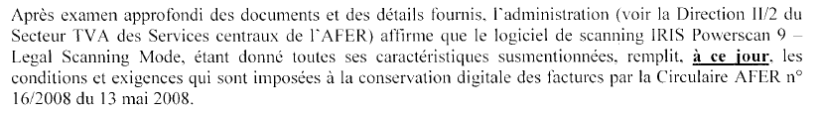
Legal Scanning with
Circular n° AFER 16/2008 (E.T.112.081) of 13 Mai 2008
Explains the basic principles for conservation and communication of invoices that are received in paper format.
I.R.I.S is proud to announce that IRISPowerscan 9 ™
is AFER compliant!

Slide 5
Legal Scanning with
What are the benefits of Legal Scanning?
Identification of the scanner operator of every image
Embedding of document owner and scanning company information in the images
Traceability of every image
Guarantee that the images cannot be altered (nor in IPS interface nor in IPS cache)
Guarantee that the sequence of the images cannot be altered
Images must be signed and cannot be deleted, moved, modified, added...
The integrity and authenticity of the images is guaranteed during the entire IPS workflow: - Scanning
    - Indexing
    - Post-Scanning
    - Processing (through extended connector)

Slide 6
Legal Scanning with
How does it work?
Identification
    The user must specify a certificate
    Either: - PKCS #12 certificate => Certificate Authorities
    - BEID (Belgian ID card) => Certipost, Zetes
    The user is associated to a particular « Legal Scanning » role for which some operations such as « image deletion », « cropping », « erasing », « rotation »… are forbidden.

Slide 7
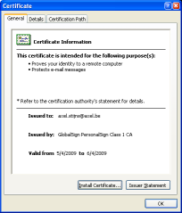
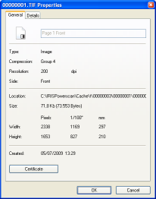
Legal Scanning with
How does it work?
Scanning
Every single image received from the scanner is signed with the provided certificate before being stored in the IPS scan cache.
  Image certificate information accessible via the properties of the image
  Embedded document owner and scan company information can also be displayed

Slide 8
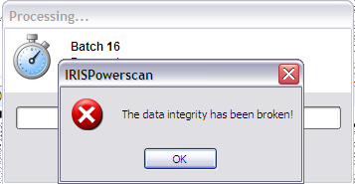
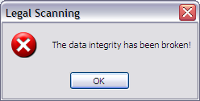
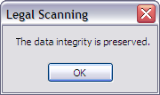

Legal Scanning with
How does it work?
Validation
The Integrity check is done before and during processing….
or « on demand », either at the batch-, document- or image level
OR

Slide 9
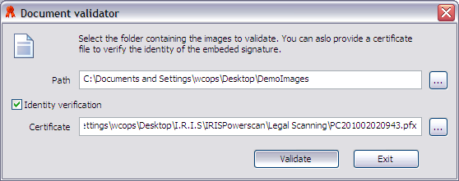
Legal Scanning with
How does it work?
Validation
IRISPowerscan comes with a standalone document validator for easy validation of entire document folders
The validator needs a certificate of in the format *.cer;*.p7b

Slide 10
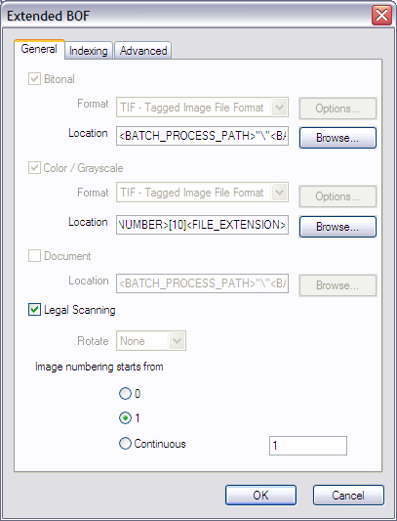
Legal Scanning with
How does it work?
Processing
The extended output connector allows you to export the images to a multipage/single page TIFF format with the embedded signature

Slide 11
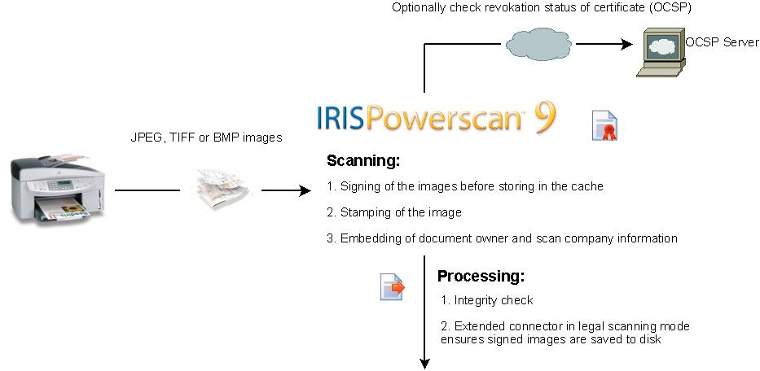
Legal Scanning with
How does it work?
IRISPowerscan™ in legal scanning mode ensures the integrity and authenticity of the images during the entire IRISPowerscan™ workflow

Slide 12
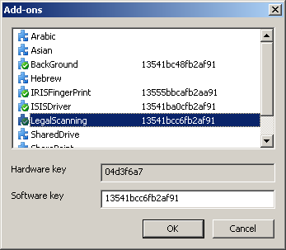
Legal Scanning with
Setup in IRISPowerscan ™
Registration

Slide 13
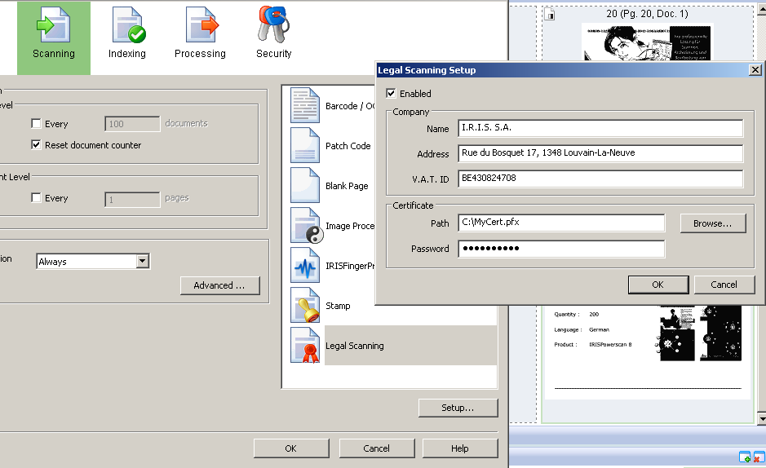
Legal Scanning with
Setup in IRISPowerscan
Legal Scanning setup
  Enable legal scanning at project level
  Provide document owner information
  Provide valid PKCS #12 certificate (.pfx) for signing

Slide 14
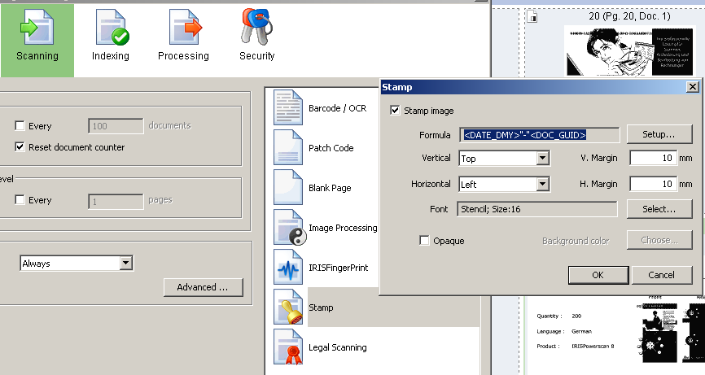
Legal Scanning with
Setup in IRISPowerscan
Stamping (optional)
  Create formula (Unique document identifier available)
  Specify position of stamp, margin, font size and type, background color to use...

Slide 15
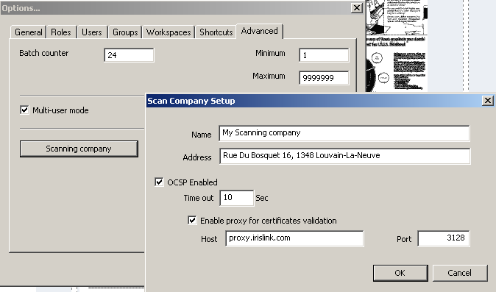
Legal Scanning with
Setup in IRISPowerscan
Scan Company Setup (optional)
  Provide scan company name and address
  Configure OCSP (Online Certificate Status Protocol) for checking revocation status of the certificate if wanted

Slide 16
Legal Scanning with
Setup in IRISPowerscan ™
Extended connector
  Enabling this will prohibit choosing the image format: the images are copied directly from the IRISPowerscan™ cache maintaining the image integrity. IRISPowerscan ™ with Legal Scanning supports the TIFF format for the moment.

Slide 17
Legal Scanning with
Any Questions?
@ 16.45h in room 6
“Legal Archiving & Records management, existing technologies and solutions”
Marc Vandeveken
I.R.I.S.

Slide 18

Thank you

